Slide 1

Customer Shopping Behavior Analysis
Uncovering insights from transactional data to guide strategic business decisions.

Slide 2

Project Overview
1
2
Data Analysis
Key Insights
3,900 purchases analyzed.
Spending patterns, customer segments, product preferences.
3
Strategic Goals
Optimize operations, reduce costs, improve forecasting.

Slide 3

Dataset Summary
Data Points
3,900 Rows
18 Columns
Key Features
Customer Demographics
Purchase Details
Shopping Behavior
Missing Data
37 values in Review Rating

Slide 4
Exploratory Data Analysis (Python)
01
02
03
Data Loading & Exploration
Missing Data Handling
Column Standardization
Imported with pandas, checked structure and summary statistics.
Imputed Review Rating with median by category.
Renamed to snake_case for readability.
04
05
Feature Engineering
Database Integration
Created age_group and purchase_frequency_days.
Loaded cleaned data to MySQL for SQL analysis.

Slide 5

Data Analysis (SQL)
Key business questions answered through structured MySQL analysis.
Revenue by Gender
1
Female: $75,191, Male: $157,890
High-Spending Discount Users
2
839 customers identified.
Top 5 Products by Rating
3
Gloves (3.86), Sandals (3.84), Boots (3.82).

Slide 6

SQL Insights: Shipping & Subscriptions
Shipping Type Comparison
Standard: $58.46 avg.
Express: $60.48 avg.
Subscribers vs. Non-Subscribers
Subscribers: 1,053 customers, $59.49 avg. spend
Non-Subscribers: 2,847 customers, $59.87 avg. spend

Slide 7
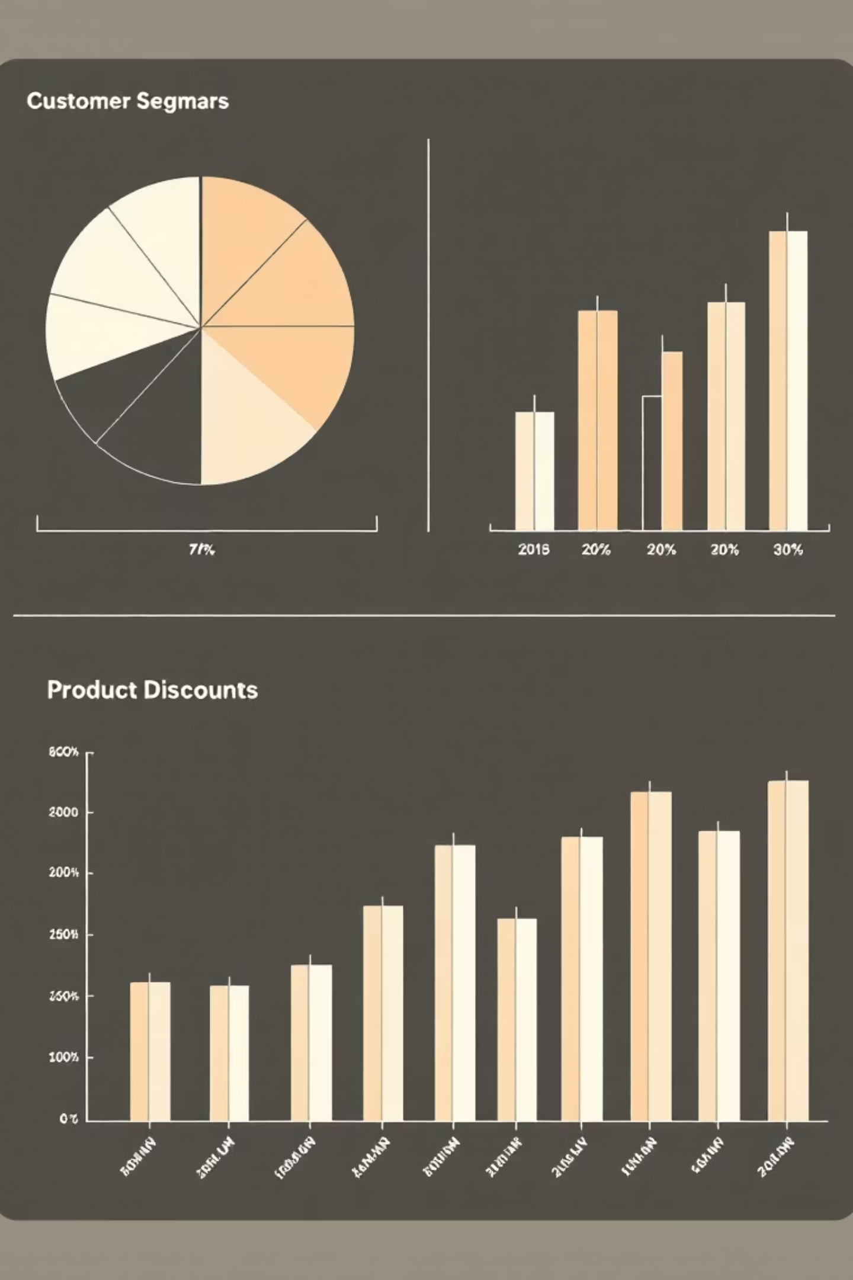
SQL Insights: Product & Customer Segmentation
Discount-Dependent Products
Hat (50%), Sneakers (49.66%), Coat (49.07%).
Customer Segmentation
Loyal (3116), Returning (701), New (83).

Slide 8

SQL Insights: Top Products & Age Groups
Top 3 Products per Category
Accessories: Jewelry, Sunglasses, Belt
Clothing: Blouse, Pants, Shirt
Footwear: Sandals, Shoes, Sneakers
Outerwear: Jacket, Coat
Revenue by Age Group
Young Adult: $62,143
Middle-aged: $59,197
Adult: $55,978
Senior: $55,763

Slide 9
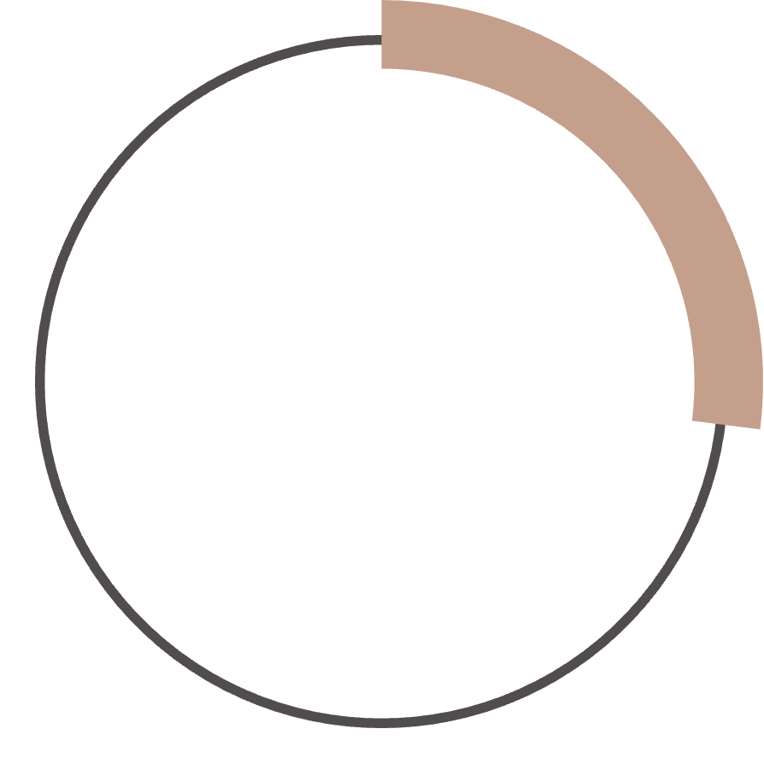


Power BI Dashboard
Interactive visualization of customer behavior insights.
27%
$59.76
3.75
Subscribers
Avg. Purchase
Avg. Review

Slide 10


Business Recommendations
Boost Subscriptions
Promote exclusive benefits.
Customer Loyalty Programs
Reward repeat buyers.
Review Discount Policy
Balance sales with margin control.
Targeted Marketing
Focus on high-revenue age groups.

